Slide 1
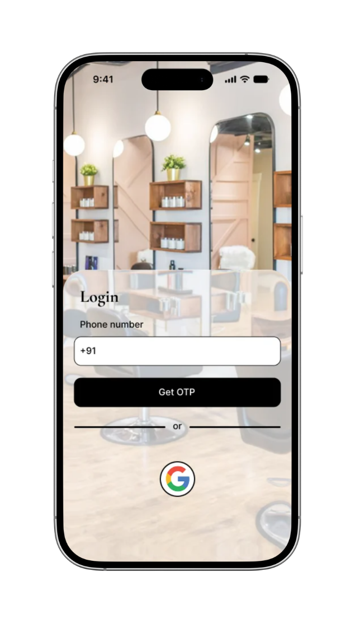
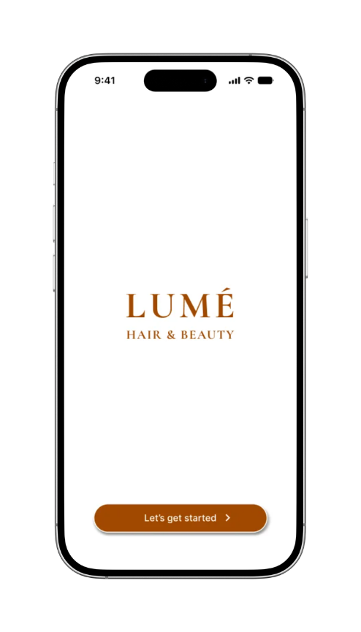
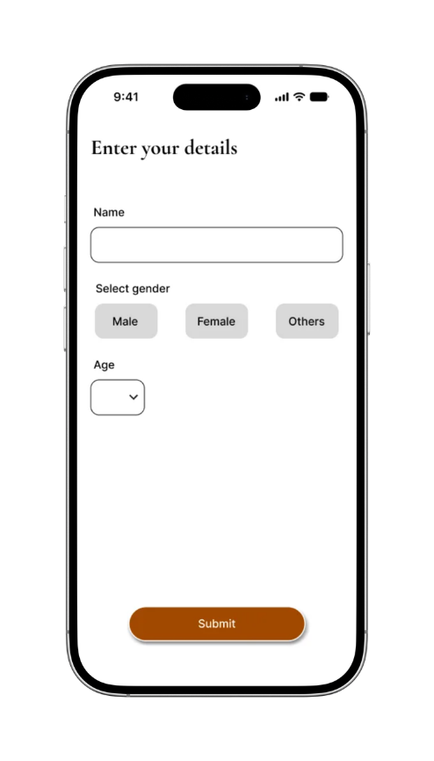
UI/UX DESIGN | MOBILE APP | 2026
LUMÉ
Salon Appointment, Simplified.
Mobile appointment booking experience for a modern salon.
Notes:
1

Slide 2
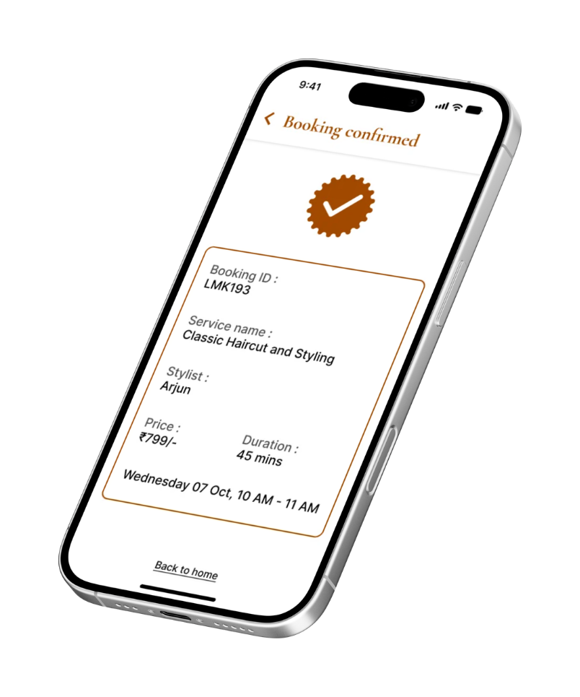
01 — THE CHALLENGE
Booking a salon appointment shouldn’t feel like a conversation.
Salon bookings often rely on calls and WhatsApp, making services, pricing and availability hard to understand.
01
02
03
04
No centralized appointment management
Unclear service information
Back-and-forth booking
Scheduling confusion
How might we make salon appointment booking simple, transparent and effortless?
Notes:
2

Slide 3
02 — RESEARCH & KEY INSIGHTS
Understanding the booking experience
SECONDARY RESEARCH
COMPETITIVE ANALYSIS
Reviewed common salon booking patterns
Compared service discovery
Studied appointment management experiences
Evaluated booking flows
Identified recurring customer pain points
Studied availability and confirmation patterns
Reviewed appointment management features
01
02
03
04
Customers need clear service information
Booking should require minimal effort
Users need confidence after confirming
Returning customers need faster rebooking
Notes:
3

Slide 4

03 — USER PERSONAS
Designing for a busy, returning customer
GOALS
FRUSTRATIONS
NEEDS
Book without calling or messaging
Waiting for replies
Clear service details
Unsure which slots are free
Fast rebooking of regular services
Know price and duration upfront
Forgetting booked appointments
Confirmation and reminders
Keep appointments organised
Maya
Busy professional and regular salon customer
Notes:
4

Slide 5

03 — USER PERSONAS
Designing for a first-time customer
GOALS
FRUSTRATIONS
NEEDS
Understand services before visiting
Unsure about pricing
Clear description, price and duration
No idea who the stylist is
Compare stylists and time slots
Simple step-by-step flow
Awkward back-and-forth to get a slot
Book with confidence
Clear confirmation before booking
Rohan
New customer trying a salon for the first time
Notes:
5

Slide 6
04 — FROM INSIGHT TO SOLUTION
Less friction. More clarity.
Designing around the real friction
PROBLEM
LUMÉ SOLUTION
Unclear services
→
Clear description + price + duration
Complex booking
→
Focused step-by-step booking flow
Booking uncertainty
→
Clear confirmation screen
Forgotten appointments
→
Booking reminders
Difficult appointment tracking
→
Upcoming bookings
Repetitive rebooking
→
One-tap rebook previous service
Notes:
6

Slide 7
05 — USER FLOWS
Two paths, one goal: a confirmed booking
New booking
For first-time and exploring customers
Open app
Book appointment
Select gender
Select service
Select stylist
Date & time
Confirm
booking
Booking done
→
→
→
→
→
→
→
Rebook
For returning customers
Open app
My bookings
Previous tab
Rebook service
Date & time
Confirm booking
Booking done
→
→
→
→
→
→
On the confirmation page, customers review their selections and confirm to complete the booking.
Notes:
7

Slide 8
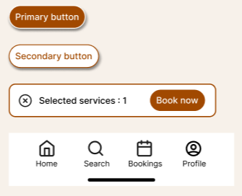

06 — DESIGN SYSTEM
A quiet, warm and consistent visual language
COLOR
TYPOGRAPHY
COMPONENTS
Aa
#A14900
Cormorant Garamond
Display · headings
#000000
Aa
#FFFFFF
Inter
Interface · body
Notes:
10

Slide 9







07 — WIREFRAMES
Notes:
10

Slide 10





07 — WIREFRAMES

Slide 11
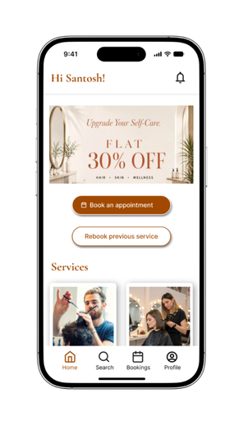
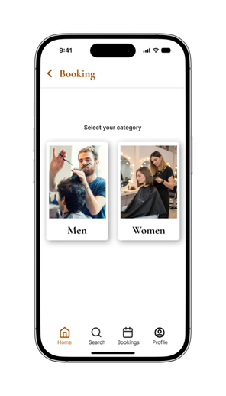
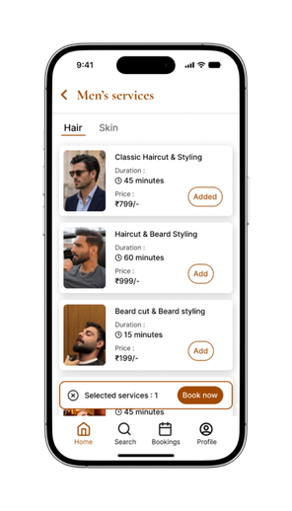
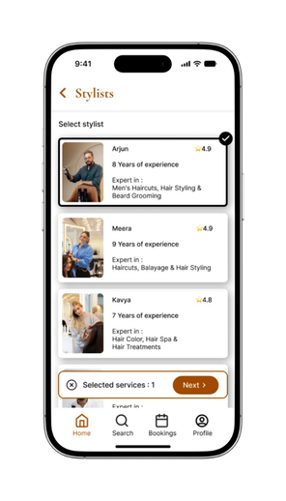
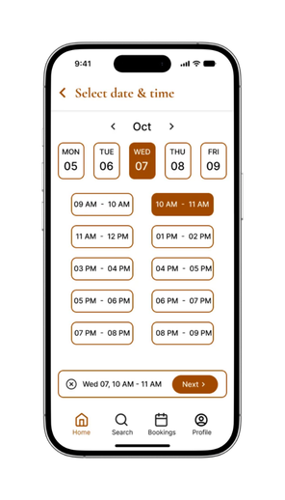
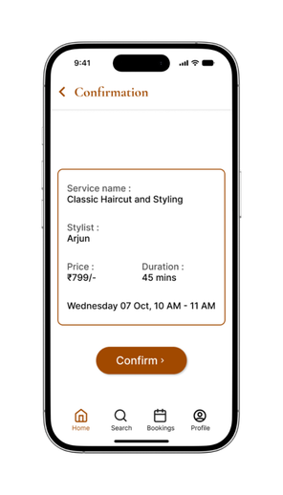
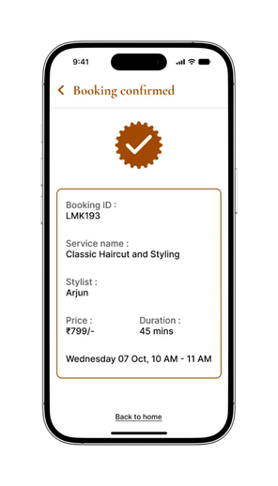
08 — THE CORE BOOKING EXPERIENCE
A focused booking journey moves customers from service discovery to confirmation without unnecessary steps.
From discovery to booking done
01
02
03
04
05
06
07
→
→
→
→
→
→
BOOK APPOINTMENT
SELECT GENDER
SELECT SERVICE
SELECT STYLIST
SELECT DATE & TIME
CONFIRM BOOKING
BOOKING DONE
Notes:
8

Slide 12
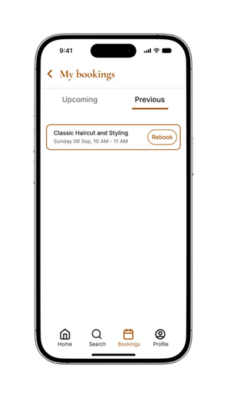

09 — DESIGNING FOR REPEAT CUSTOMERS
REBOOK
01 REBOOK PREVIOUS SERVICE
03 SELECT DATE & TIME
05 BOOKING DONE
Not every booking needs to start from zero.
Faster repeat bookings
Less decision-making
Better convenience for returning customers
Designed for the second booking, not just the first.
02 SELECT PREVIOUS SERVICE
04 CONFIRM BOOKING
Notes:
9

Slide 13
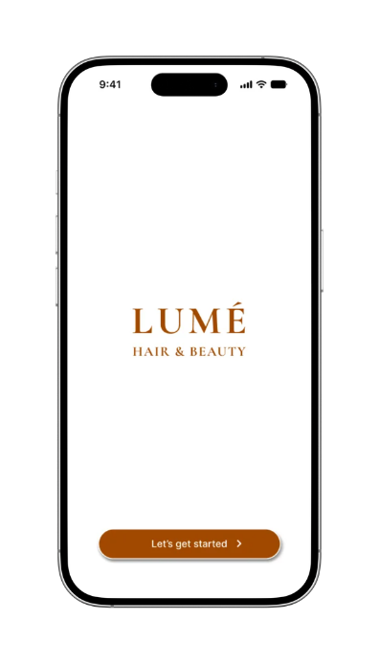

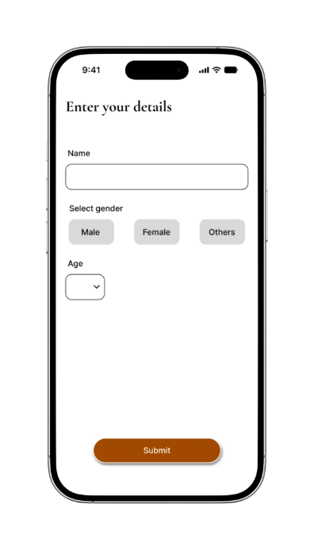

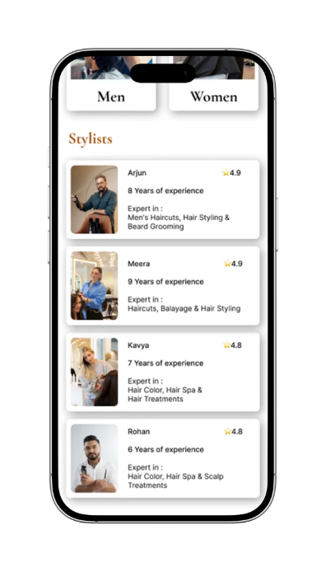
Designed to feel as effortless as the service itself.
✓ Clear service pricing & duration
✓ Simple booking flow
✓ Stylist selection
✓ Date & time availability
✓ Booking confirmation
✓ Upcoming appointments
✓ Reminders
✓ Previous-service rebooking
Notes:
11

Slide 14
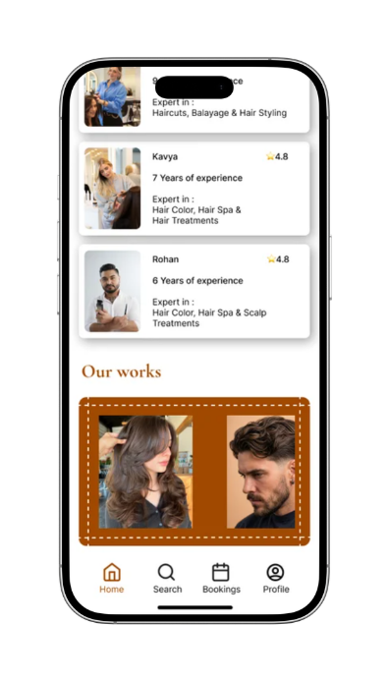
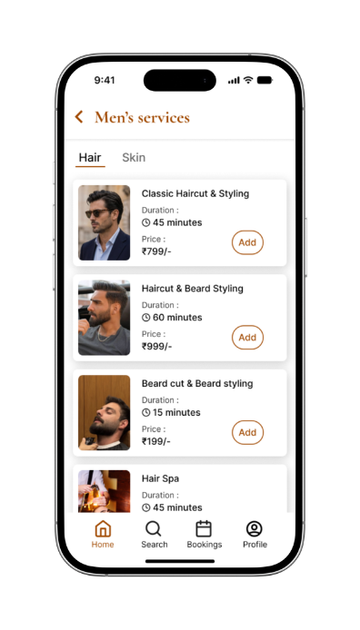
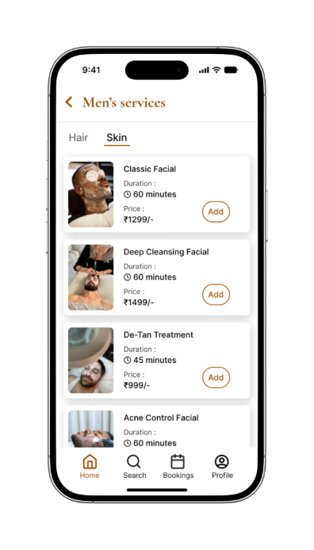
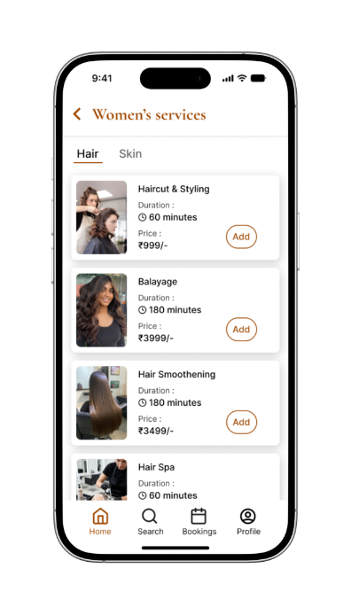
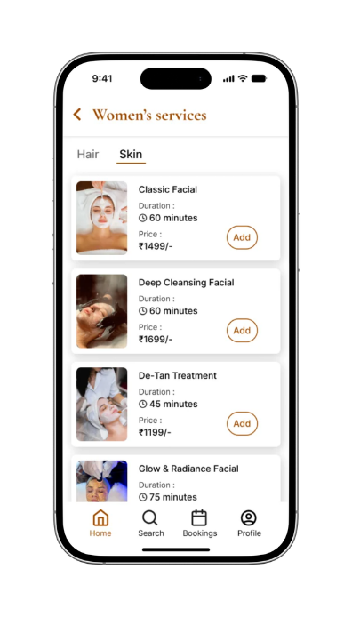
Notes:
11

Slide 15
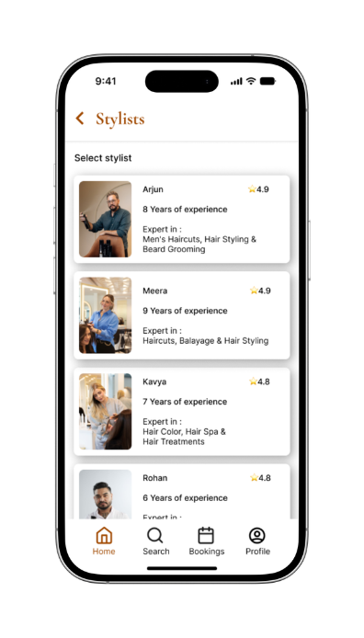
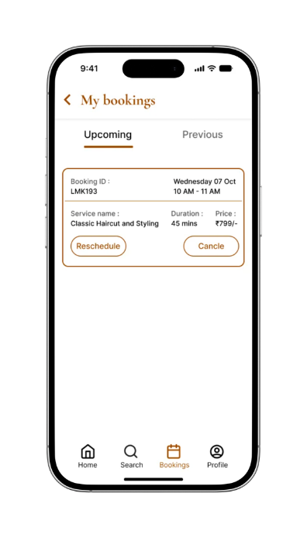
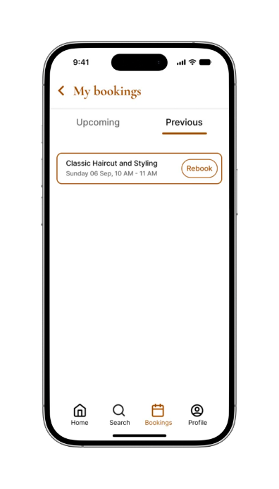
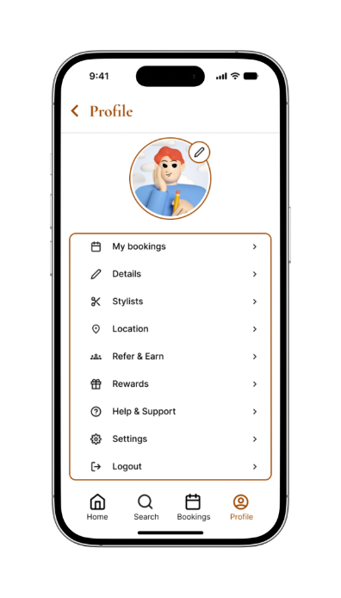
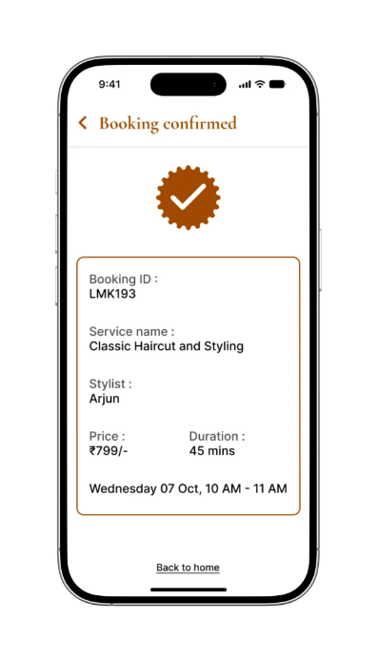
Notes:
11

Slide 16
10 — OUTCOME
A simpler way to book better.
LUMÉ transforms a fragmented salon booking process into a clear, convenient and repeatable mobile experience.
01
02
03
CLARITY
CONVENIENCE
CONTINUITY
Customers understand services before booking.
Customers can book and manage appointments in fewer steps.
Returning customers can quickly rebook previous services.
Discover. Book. Relax. Repeat.
LUMÉ · Mobile Appointment Booking Experience
Notes:
12

